Slide 1
CSCE 3600 Principles of Systems Programming Bourne Again Shell (Bash)
University of North Texas

Slide 2


Shell as a User Interface
A shell is a command interpreter, an interface between a human (or another program) and the OS
Runs a program, perhaps the ls program
Allows you to edit a command line
Can establish alternative sources of input and destinations for output for programs
The terminal is a program that opens a graphical window and lets you interact with the shell.
Shell is the interface between end users and the Linux system, similar to the commands in Windows

Slide 3
Bourne-Again Shell (bash)
Extension of the Bourne Shell (sh)
Check the version:
which bash
bash --version
Incorporates many useful features from the Korn shell (ksh) and C shell (csh) C shell is a command processor which is typically run in a text window, allowing the user to type and execute commands.
There are other shell versions:
tcsh, zsh, csh, ksh, etc.
Why shell?
For routing jobs, such as system administration, without writing programs

Slide 4
Shell’s Responsibilities
program
execution
interpreted
programming
languages
variable and
filename
substitution
Shell
environment
control
I/O
Redirection
pipeline
hookup

Slide 5
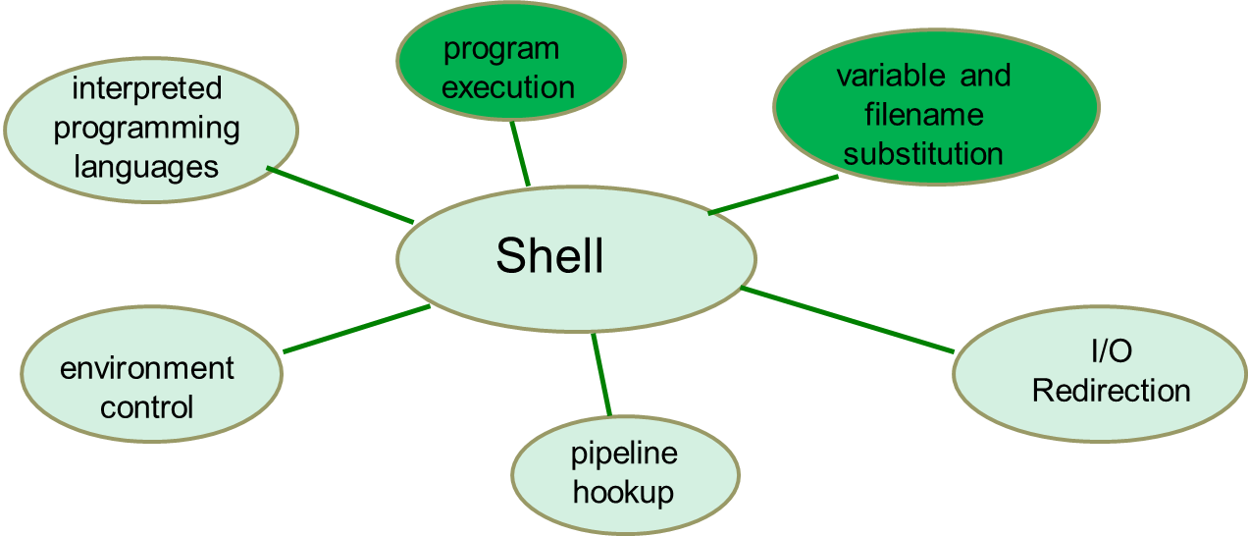
Shell’s Responsibilities
Program execution
The shell executes all programs requested by the user
Each line interpreted according to format: program_name arguments
White space between the program name and the individual arguments is ignored
Some commands, like cd, pwd, and echo are built into the shell
The rest are utilities that the shell must retrieve from the disk
Variable and file name substitution
The shell permits users to create shell variables that can be assigned values, just as in any of the common programming languages
The shell also permits use of “wildcard” characters to generate lists of files to be passed to the chosen command or utility
These “wildcards” consist of characters such as the *, ? and [...]
The wildcard is replaced by the appropriate files, which are then passed on the command line to the utility

Slide 6
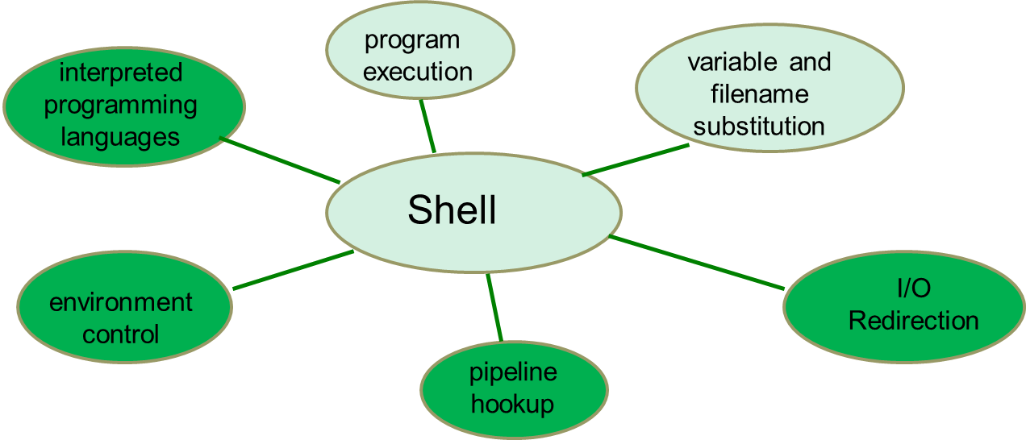
Shell’s Responsibilities
I/O Redirection
The shell takes care of all redirection of input and output, scanning for the redirection symbols like <, >, and >>
Pipeline Hookup
The shell is also responsible for detecting the use of the pipe symbol |, and connecting the standard output of the preceding command with the standard input of the succeeding command
Environment Control
The shell environment can be customized by each user to include the default home directory, the cursor presented by the shell for prompting and other options to be discussed later
Interpreted Programming Languages
The shell provides a built-in capability for developing fairly complicated programs, or “shell scripts” to automate repetitive tasks
It includes variables, arrays, decision making capabilities, looping constructs and arithmetic operations

Slide 7
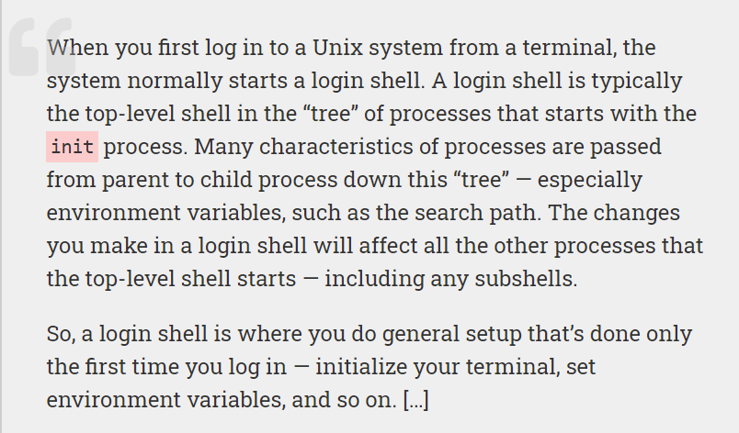
Shell Startup
A login shell is a shell that is started at startup by the init process (or systemd process nowadays).
Or
A shell that logs you into the system by your providing a username and a password.
A non-login shell, by contrast, is a shell that is invoked without logging anybody in.

Slide 8
Shell Startup
The shell is actually the result of the login process
Starting off with the kernel’s booting processes, key processes involved in starting up the shell include:
init
Invoked by kernel at end of startup procedure, the init process is responsible for starting up and shutting down the system
getty
Created by the init process, the getty process is responsible for getting and managing the terminal type (tty)
login
After communication is established, the login process authenticates the user
Once authenticated, the appropriate shell is created
systemd
replaced by systemd nowadays in many Linux distributions

Slide 9
Shell Metacharacters
Some characters have special meaning to the shell
These are just a few:
I/O redirection
< > |
Wildcards
* ? [ ]
Others
& ; $ ! \ ( ) space tab newline
These must be escaped or quoted to inhibit special behavior

Slide 10
Shell Substitutions
Certain characters are interpreted by the various Linux shells as “wildcards” for filenames, also known as metacharacters through globbing
* Matches 0 or more of any character
ls *.c
? Matches any single character
ls file0?.c
[...] Matches any single character if it is in list provided
ls file[0-9].c
ls [a-zA-Z]*
ls [!0-9]*

Slide 11
Basic Shell Scripting
A shell script is a file that contains shell commands
Data structure: variables
Control structure: arithmetic, functions, branches, loops
Specify shell to execute program
Script must begin with #! (pronounced “shebang”) to identify shell to be executed
#! /bin/bash
To run:
Make executable: chmod +x hello.sh
Invoke via: ./hello.sh
/bin/bash is the most common shell used as default shell for user login of the linux system
Make the script executable with command chmod +x <fileName>
Typically, use .sh extension to indicate shell script

Slide 12
Example "hello" Script
#! /bin/bash
echo "You are logged in as ($USER) to machine (`uname -n`)."
echo "This month’s calendar is:"
cal
echo "You are currently running the following processes:"
ps u
The ps command, short for Process Status. ps is a command line utility that is used to display or view information related to the processes running in a Linux system.

Slide 13
Subshells
A subshell is a new shell created within current shell
Each subshell has its own environment
A subshell can be created by:
Executing the bash command
Starting a background process
Running a shell script
Grouping shell commands within parentheses
pwd; (cd /; pwd); pwd
A subshell cannot change a variable in parent shell
Subshell variables destroyed on exit
Definition: A subshell is a child process launched by a shell (or shell script).

Slide 14
Environment Variables
Bash supports two types of variables:
Local variables
Environment variables, such as $USER seen earlier
Environment variables are set by the system and can usually be found using the env command
env [options] [varname=value] [command]
Displays the current environment or modifies the specified variables
Specified commands are executed in the new environment

Slide 15
The $PATH Variable
Initially set when the shell is created (login process)
Provides a list of available directories where an executable command may be found
Add new “path” to environment variable
PATH=$PATH:$HOME/bin
export PATH
This allows us to include another directory in the search path for command
Directories are separated by colon (:)
command not found message returned on unsuccessful search
This line is defining the PATH for your logon in the bash shell as the general PATH variable -- $PATH -- plus your home directory -- $HOME -- subdirectory bin.
To add a directory to the PATH just edit this line including a colon : and the new directory. For example to add: /usr/programs/bin to the PATH you would change the line to:
PATH=$PATH:$HOME/bin:/usr/programs/bin

Slide 16
Shell Scripting Features
Full scripting language
Conditional statements (if-then-else, case, …)
Arithmetic, string, file, environment variables
Input (prompt user, command-line arguments, …)
Loop statements (for, while, do-while, repeat-until, …)
Lists (and, or)
Functions
Traps
Small differences among shells
Bash has a 3000+ line man page

Slide 17
Local Variables
Variable structure format
varname=value
Variable name must begin with alphabetic or underscore character, followed by zero or more alphanumeric or underscore characters
Note there should not be any spaces around the '=' sign
Variables are case-sensitive
Do not use globbing metacharacters, such as ? and *, in your variable names
Once defined, use by prefixing $ symbol to variable name
Example
score=100
echo You scored a $score on the exam

Slide 18
Local Variables
Example
cat test1.sh
echo %$var1%
./test1.sh
%%
var1 is equal to NULL
cat test2.sh
var2=25
echo %$var2%
./test2.sh
%25%
var2 is equal to 25

Slide 19

Exported Variables
Variables can be exported
The value of the variable can be passed to other subshells
Export command format:
export [varname]
Caution
Changing an exported variable in a subshell does not change the value in the parent shell

Slide 20
Exported Variables (cont’d)
Example
cat test3.sh
var3=2345
echo var3 = $var3
./test3.sh
var3 = 2345
cat test4.sh
echo var3 = $var3
./test4.sh
var3 =
var3 is a local variable, so its value in test3.sh is 2345 while its value in test4.sh is null

Slide 21
Exported Variables (cont’d)
Example
var3=2345
export var3
cat test3.sh
var3=2345
echo var3 = $var3
./test3.sh
var3 = 2345
./test4.sh
var3 = 2345
var3 is an exported variable, so its value in test3.sh is 2345 and its value in test4.sh is also 2345

Slide 22
Exported Variables (cont’d)
Once a variable is exported, it is maintained as an exported variable
Each subshell makes its own copy of the variable
Unless you use unset to destroy it
export with no arguments lists the variables that are exported to the user’s shell

Slide 23
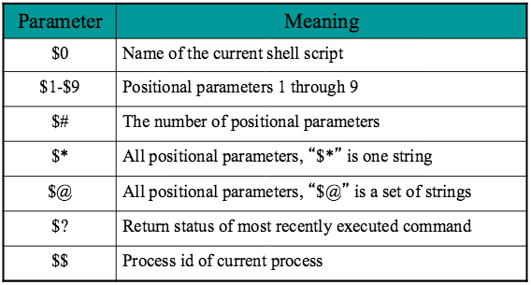
Special Shell Variables
Arguments can be used to modify script behavior
Command-line arguments become positional parameters to shell script

Slide 24
Command Line Arguments Example
set tim bill ann fred
$1 $2 $3 $4
echo $*
tim bill ann fred
echo $#
4
echo $1
tim
echo $3 $4
ann fred
The ‘set’ command can be used to assign values to positional parameters

Slide 25
User Input
Bash allows to prompt for and read in user input
The read command allows you to prompt for input and store it in a variable
Syntax:
read varname [varname1] [varname2] … [varnameN]
or
read –p "prompt" varname1 [varname2] … [varnameN]
Input entered by user are assigned to varname1, varname2, etc.
If more input is entered than there are variables, the remaining input will be assigned to the last variable

Slide 26
Quoting Mechanisms
Quote characters and the backslash character have special meaning in shell scripts
` perform command substitution ` uname `
" allow some variable expansion, but prevent wildcard replacement
' prevent wildcard replacement as well as variable and command substitution
\ preserve the literal value of the next character
The general rule is that double quotes still allow expansion of variables within the quotes, and single quotes do not

Slide 27
Using Quotes
Example (single quote):
cat city
Austin
Dallas
Ft. Worth
San Antonio
grep 'San Antonio' city
San Antonio

Slide 28
Using Quotes
Example (double quote):
var1="'Dallas,' A city in Texas"
echo $var1
'Dallas,' A city in Texas
var2='"San Antonio," is also a city in Texas'
echo $var2
"San Antonio," is also a city in Texas

Slide 29
Using Quotes
Example (backslash):
echo $var2
"San Antonio," is also a city in Texas
echo \$var2
$var2
which is the same as:
echo '$'var2
$var2

Slide 30
Using Quotes
Example (back quote):
echo The date and time is: `date`
The date and time is: Mon Feb 10 15:37:50 CDT 2020

Slide 31
Using Quotes
Expands *
echo *
Does not expand *
echo "*"
Does not expand *
echo '*'
Performs command substitution and expands $HOME and *
echo "$HOME directory files `ls *`"
Performs command substitution and expands *, but not $HOME
echo "\$HOME directory files `ls *`"
No command substitution nor expands $HOME and *
echo '$HOME directory files `ls *`'

Slide 32
Arithmetic Evaluation
let statement can be used to perform arithmetic operations
Available operators are: +, –, *, /, %
let X=10+2*7
echo $X
let Y=X+2*4
echo $Y
An arithmetic expression can be evaluated by:
$[expression] or $((expression))
echo "$((123+20))"
VALORE=$[123+20]
echo "$[123*$VALORE]"

Slide 33
Condition Expressions
Conditionals let us decide whether to perform an action or not by evaluating an expression
Condition expressions must be enclosed in either
Single brackets [ … ] are built-in in bash as an alias for the test command
Conditions can also be evaluated without the single brackets using the test command with the general format
if test condition
Double brackets [[ ... ]] is a bash keyword and is much more capable than single brackets, though may not be supported by all versions (bash, zsh, and ksh support it)
Also allows for more C-like syntax with relational operators

Slide 34
Condition Expressions
The most basic form of condition expressions is:
if [ expression ]
then
statement(s)
elif [ expression ]
then
statement(s)
else
statement(s)
fi
The elif (else if) and else sections are optional
Put spaces after [ and before ], and around the operators and operands

Slide 35
The test File Operator
The test file operator returns true if:
–d file file is a directory
–f file file is an ordinary file, and exists
–r file file is readable by the process
–s file file is not empty
–w file file is writable by the process
–x file file is executable
–G file file is owned by the group user belongs to
–O file file is owned by the user
–u file set_user_id bit is set
–g file set_group_id bit is set

Slide 36
The test Command
Example (using the test command)
if test –w "$1"
then
echo "file $1 is writeable"
fi
More examples (using single brackets)
[ –f /usr/train1/file1 ]
If file1 exists and is an ordinary file
[ –r /usr/train2/file1 ]
If file1 exists and is readable by this process
[ –s /usr/train3/file1 ]
If file1 exists and is not empty

Slide 37
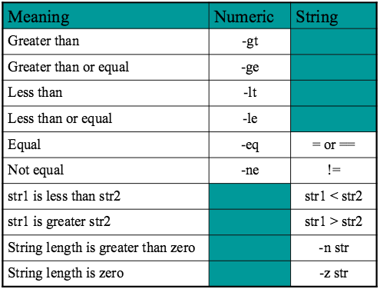
Relational Operators

Slide 38
Logical Operators
Compound expressions formed with logical operators
! expression logical negation
expression1 –a expression2 logical and
expression –o expression logical or
Examples
[ ! –f /usr/train1/file1 ]
[ –f /usr/train1/file1 –a –r /usr/train1/file1 ]
[ –n "$var1" –o –r /usr/train2/file1 ]
The && (and) and || (or) logical operators may also be used, but must be enclosed in [[ … ]]

Slide 39
Example if … Statement
# The following three if-conditions produce the same result
#! /bin/bash
# DOUBLE SQUARE BRACKETS
read –p "Do you want to continue? " reply
if [[ $reply = "y" ]]; then
echo "You entered " $reply
fi
# SINGLE SQUARE BRACKETS
read –p "Do you want to continue? " reply
if [ $reply = "y" ]; then
echo "You entered " $reply
fi
# “TEST” COMMAND
read –p "Do you want to continue? " reply
if test $reply = "y"; then
echo "You entered " $reply
fi

Slide 40
The case Statement
Use the case statement for a decision that is based on multiple choices
Syntax:
case value in
pattern1) statement-list1
;;
pattern2) statement-list2
;;
…
patternN) statement-listN
;;
esac
The first pattern to match value will be executed
Patterns may also contain meta-characters, such as *, ?, [ … ], and character classes
Multiple patterns are also supported through the use of the | operator

Slide 41
The case Statement Example 1
#! /bin/bash
echo "Enter Y to see all the files including hidden files"
echo "Enter N to see all non-hidden files"
echo "Enter q to quit"
read –p "Enter your choice: " reply
case $reply in
Y|YES) echo "Displaying all (really…) files"
ls –a ;;
N|NO) echo "Displaying all non-hidden files"
ls ;;
*) echo "Invalid choice! "; exit 1 ;;
esac

Slide 42
The case Statement Example 2
#! /bin/bash
ChildRate=3
AdultRate=10
SeniorRate=7
read –p "Enter your age: " age
case $age in
[1-9]|[1][0-2]) # child, age 1 - 12
echo "Your rate is" '$' "$ChildRate.00" ;;
[1][3-9]|[2-5][0-9]) # adult, age 13 - 59
echo "Your rate is" '$' "$AdultRate.00" ;;
[6-9][0-9]) # senior, age 60+
echo "Your rate is" '$' "$SeniorRate.00" ;;
esac

Slide 43
The while Loop
Bash supports the while loop to execute statements as long as the condition holds true with the following format:
while [ expression ]
do
statement1
statement2
…
statementN
done

Slide 44
Using the while Loop Example 1
#! /bin/bash
index=1
while [ $index -le 10 ]
do
echo loop: $index
let index=$index+1
done
-le is less than or equal to

Slide 45
Using the while Loop Example 2
#! /bin/bash
Again="Y"
while [ $Again = "Y" ]; do
ps u
read –p "Do you want to continue? (Y/N) " reply
Again=`echo $reply | tr [:lower:] [:upper:]`
done
echo "done"

Slide 46
The until Loop
Bash supports the until loop to execute statements as long as the condition holds false with the following format:
until [ expression ]
do
statement1
statement2
…
statementN
done

Slide 47
Using the until Loop Example 1
#! /bin/bash
COUNTER=20
until [ COUNTER –lt 10 ]
do
echo $COUNTER
let COUNTER–=1
done
-lt is less than
20
19
10

Slide 48
Using the until Loop Example 2
#! /bin/bash
stop="N"
until [ $stop = "Y" ]; do
ps
read –p “Do you want to stop? (Y/N) " reply
stop=`echo $reply | tr [:lower:] [:upper:]`
done
echo "done"

Slide 49
The for Loop
Although the for loop is supported in the traditional sense (i.e., when the number of iterations is known), we look at using the for loop to iterate over a list of arguments with the following format:
for varname in arg1 arg2 … argN
do
statement1
statement2
…
statementN
done
The for loop is a little different from other programming languages as it basically lets you iterate over a series of “words” within a string

Slide 50
Using the for Loop Example 1
#! /bin/bash
for i in 7 9 2 3 4 5
do
echo $i
done
The simplest form will iterate over all command line arguments:
#! /bin/bash
for parm
do
echo $parm
done

Slide 51
Using the for Loop Example 2
#! /bin/bash
for quizNum in 1 2 3 4 5
do
read -p "Enter quiz #$quizNum: " score
let sum=$sum+$score
done
let quizAvg=$sum/5
echo "Average quiz grade: $quizAvg"
Note this computation results in integer values only!
If we wanted accurate floating-point results, we must use a precision calculator, such as bc

Slide 52
A C-like for Loop
An alternative form of the for structure is:
for (( expression1 ; expression2 ; expression3 ))
do
statement1
statement2
…
statementN
done
#!/bin/bash echo –n "Enter a number: "; read x
let sum=0
for (( i=1 ; $i<=$x ; i=$i+1 ))
do
let "sum = $sum + $i"
done
echo "sum of first $x numbers is: $sum"

Slide 53
The select Command
select command constructs simple menu from a list
Allows user to enter a number instead of a string value
User enters sequence number corresponding to the argument in the list
select value in LIST
do
statement(s)
done

Slide 54
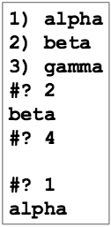
Using select Example
select_command.sh
#! /bin/bash
select var in alpha beta gamma
do
echo $var
done

Slide 55
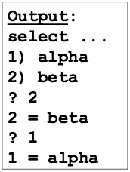
The select Command in Detail
selectcommandindetail.sh
PS3 is select sub-prompt prompt statement
It is the prompt used by “select” inside shell script
Prompt statements: PS1, PS2, PS3, PS4, PROMPT_COMMAND
$REPLY is user input (the number)
#! /bin/bash
PS3="select entry or ^D: "
select var in alpha beta
do
echo "$REPLY=$var"
done

Slide 56
break and continue
Interrupts the for, while, or until loop
The break statement
Transfers control to the statement after the done statement
Terminates execution of the loop
The continue statement
Transfers control to the done statement
Skips the test statements for the current iteration
Continues execution of the loop

Slide 57
The break Command
while [ condition ]
do
statement1
break
statementN
done
echo "done"
This iteration is over and there are no more iterations

Slide 58
The continue Command
while [ condition ]
do
statement1
continue
statementN
done
echo "done"
This iteration is over;
do the next iteration

Slide 59
continue and break Example
continue_break.sh
for index in 1 2 3 4 5 6 7 8 9 10
do
if [ $index –le 3 ]; then
echo "continue"
continue
fi
echo $index
if [ $index –ge 8 ]; then
echo "break"
break
fi
done

Slide 60
Shell Functions
A shell function is similar to a shell script
Stores a series of commands for execution later
Shell stores functions in memory
Shell executes a shell function in the same shell that called it (not a subshell)
Must be defined before they can be referenced
Usually placed at the beginning of the script
function-name()
{
statements
}

Slide 61
Function Example 1
function1.sh
#! /bin/bash
funky()
{
# This is a simple function
echo "This is a funky function."
echo "Now exiting funky function."
}
# declaration must precede call:
funky

Slide 62
Function Example 2
function2.sh
#! /bin/bash
fun()
{ # A somewhat more complex function.
JUST_A_SECOND=1
let i=0
REPEATS=30
echo "And now the fun really begins."
while [ $i –lt $REPEATS ]
do
echo "-------FUNCTIONS are fun-------->"
sleep $JUST_A_SECOND
let i+=1
done
}
fun

Slide 63
Function Parameters
Functions do not need to define formal parameters
They are supported by positional parameters (i.e., $1, $2, …) for each argument passed to the function
$# reflects number of parameters
$0 still contains name of script (not name of function)
Functions invoked with or without parameters
But no parentheses are needed in the function call

Slide 64
Function with Parameter Example 1
function3.sh
#! /bin/bash
testfile()
{
if [ $# –gt 0 ]; then
if [[ –f $1 && –r $1 ]]; then
echo $1 is a readable file
else
echo $1 is not a readable file
fi
fi
}
testfile .
testfile funtest
$# contains the number of parameters passed to the testfile function.
. and funtest are parameters to the testfile function

Slide 65
Function with Parameter Example 2
#! /bin/bash
checkfile()
{
for file
do
if [ -f "$file" ]; then
echo "$file is a file"
else
if [ -d "$file" ]; then
echo "$file is a directory"
fi
fi
done
}
checkfile . funtest

Slide 66
Local Variables in Functions
Variables defined within functions are global
Their values are known throughout the entire shell program
Keyword “local” inside a function definition makes referenced variables “local” to that function

Slide 67
Function Variables Example
#! /bin/bash
global="pretty good variable"
checkvar()
{
local inside="not so good variable"
echo $global
echo $inside
global="better variable"
}
echo $global
checkvar
echo $global
echo $inside

Slide 68
Using Arrays
Arrays up to 1024 elements are created when used in one of two subscript forms:
pet[0]=dog
pet[1]=cat or pet=([0]="dog" [1]="cat" [2]="fish") or pet=(dog cat fish)
pet[2]=fish
To extract a value, use ${arrayname[i]}
echo ${pet[0]}
To extract all elements, use ${arrayname[*]}
You can combine arrays with loops using a for loop
for x in ${arrayname[*]}
do
…
done
${#arrayname[*]} for number of elements in array

Slide 69
String Manipulation
Bash supports a number of string manipulation operations
${#string} gives the string length
${string:pos} extracts substring from $string at $pos
${string:pos:len} extracts $len characters from $string at $pos
Example
str=0123456789
echo ${#str}
echo ${str:6}
echo ${str:6:2}

Slide 70
Ctrl+Shift+Esc -------- > Task Manager
Ctrl+Shift+Del -------- > Menu of options

Slide 71
Signal Handling
Linux allows you to send a signal to any process
Any Linux process can be interrupted by a signal
Ctrl-C (^C) typed via keyboard either stops a program from running or terminates bash
Signal end of input with EOF signal, Ctrl-D (^D)
Pressing Ctrl-D at the shell causes the shell to exit
What if you don’t want to exit the shell?
ignoreeof=1 bash
To see a list of supported signals in Linux
kill –l

Slide 72
Signal Handling
$ kill -l
1) SIGHUP 2) SIGINT 3) SIGQUIT 4) SIGILL 5) SIGTRAP
6) SIGABRT 7) SIGBUS 8) SIGFPE 9) SIGKILL 10) SIGUSR1
11) SIGSEGV 12) SIGUSR2 13) SIGPIPE 14) SIGALRM 15) SIGTERM
16) SIGSTKFLT 17) SIGCHLD 18) SIGCONT 19) SIGSTOP 20) SIGTSTP
21) SIGTTIN 22) SIGTTOU 23) SIGURG 24) SIGXCPU 25) SIGXFSZ
26) SIGVTALRM 27) SIGPROF 28) SIGWINCH 29) SIGIO 30) SIGPWR
31) SIGSYS 34) SIGRTMIN 35) SIGRTMIN+1 36) SIGRTMIN+2 37) SIGRTMIN+3
38) SIGRTMIN+4 39) SIGRTMIN+5 40) SIGRTMIN+6 41) SIGRTMIN+7 42) SIGRTMIN+8
43) SIGRTMIN+9 44) SIGRTMIN+10 45) SIGRTMIN+11 46) SIGRTMIN+12 47) SIGRTMIN+13
48) SIGRTMIN+14 49) SIGRTMIN+15 50) SIGRTMAX-14 51) SIGRTMAX-13 52) SIGRTMAX-12
53) SIGRTMAX-11 54) SIGRTMAX-10 55) SIGRTMAX-9 56) SIGRTMAX-8 57) SIGRTMAX-7
58) SIGRTMAX-6 59) SIGRTMAX-5 60) SIGRTMAX-4 61) SIGRTMAX-3 62) SIGRTMAX-2
63) SIGRTMAX-1 64) SIGRTMAX
List your processes with ps u or ps –u userid
–1 = hangup kill –SIGHUP 1234
–2 = interrupt with ^C kill –2 1235
no argument = terminate kill 1236
–9 = kill (force terminate) kill –9 1237

Slide 73
Handling Signals
Default action for most signals is to end process
Bash allows you to install a custom signal handler
Syntax:
trap ['handler command'] signal1 [signal2] … [signalN]
The 'handler command' can be a single command, such as echo, or it can be a function call
trap followed only by signal number resets signal handler
Example
trap 'echo do not hangup' 1 2

Slide 74
Trap Hangup Example
traphangup.sh
#! /bin/bash
# kill –1 won’t kill this process
# kill –2 will (may not always work)
trap 'echo do not hang up' 1
while true
do
echo "try to hang up"
sleep 1
done

Slide 75
Trap Multiple Signals Example
trapmultiple.sh
#! /bin/bash
# plain kill or kill –9 will kill this SIGKILL
trap 'echo 1' 1
trap 'echo 2' 2
while true
do
echo –n .
sleep 1
done

Slide 76
Restoring Default Handlers
Use this to run a signal handler once only
#! /bin/bash
trap 'echo SIGHUP will not work' 1
trap 'suppressonce' 2
suppressonce()
{
echo "SIGINT suppressed"
trap 2 # reset it (may not always work)
}
while true
do
echo -n "."
sleep 1
done
Be aware that when using custom signal handlers, its behavior can be somewhat flaky and not work every time

Slide 77
Debugging Shell Scripts
Bash provides two useful options for debugging:
echo
Use explicit output statements to trace execution
set with options to allow flow of execution
–v option prints each line as it is read
–x option displays the command and its arguments
–n option checks for syntax errors
Options can be turned on or off
To turn on the option: set –xv
To turn off the option: set +xv
Options can also be set via she-bang line
#! /bin/bash –xv
May also execute in debug mode at command line:
bash –x scriptname.sh

Slide 78
Debugging Example
#!/bin/bash –x
echo –n "Enter a number: "; read x
let sum=0
for (( i=1 ; $i<$x ; i=$i+1 ))
do
let "sum = $sum + $i"
done
echo "the sum of the first $x numbers is: $sum"

Slide 79
Summary of Shell command execution order
Keyboard
Terminal Emulator
Shell
Kernel
Screen
Terminal Emulator
Shell

